Slide 1
FAKE NEWS DETECTION
-CS22B1018
-CS22B1071
-CS22B2017

Slide 2
Problem Statement
Fake news spreads rapidly online, affecting public opinion and stability.
Traditional fact-checking is slow, so there's a need for real-time, automated detection using text, visuals, and context—while tackling bias, subtle misinformation, and diverse sources.
Objective: To develop a robust text classification model using RoBERTa that captures semantic meaning and performs well even on linguistically challenging inputs.
Key challenges addressed: – Contextual ambiguity – Class imbalance – Long sequence handling – Domain adaptability

Slide 3
DATASET DETAILS
• Source of Dataset: ISOT Dataset https://onlineacademiccommunity.uvic.ca/isot/2022/11/27/fake-news-detection-datasets/
• Size and Split: – Total samples: 38,163 – Training set: 31,428 – Validation set: 6,735 – Test set: 6,735
• Features: – Input: Raw text data (pre-tokenized)
– Pre-tokenized Format: Text data is not structured numerically and must be tokenized into a format compatible with transformer-based models.
– Target Feature: The output labels are categorical values representing different classes (e.g., positive/negative, or label 0/1 for binary classification).

Slide 4
• Preprocessing Applied – Text Cleaning: Performed basic preprocessing such as converting all text to lowercase, removing special characters, punctuation, and unnecessary whitespace to reduce noise. – Tokenizer: Used the pretrained RoBERTa tokenizer from HuggingFace to split raw text into subword tokens. Tokenizer handles unknown words using byte pair encoding (BPE). – Token IDs and Attention Masks: Each sentence was converted to a fixed-length sequence of token IDs. Padding was applied where necessary, and attention masks were created to differentiate between padded and actual tokens. – Maximum Length: Defined a maximum sequence length (e.g., 128 or 256) to ensure uniform input size across batches.
• Class Balance – Label Distribution Check: Analyzed the dataset for class imbalance using value counts or histograms. – Class Weighting: If imbalance was detected, adjusted the loss function (e.g., CrossEntropyLoss(weight=class_weights)) to give higher importance to minority classes. – Sampling : In highly skewed scenarios, techniques like oversampling the minority class or under-sampling the majority class were considered to ensure balanced learning.

Slide 5
Model Architecture
• Model Used: – A fine-tuned version of RoBERTa-base, a transformer-based language model known for its robust contextual understanding and pretraining on large corpora. – Selected for its superior performance in NLP classification tasks, especially in scenarios requiring nuanced text interpretation.
• Base Configuration: – Model initialized using HuggingFace’s transformers library. – Architecture: 12-layer transformer with 768 hidden units and 12 self-attention heads. – The pretrained model weights were loaded and adapted for the binary classification task.
• Classification Head: – A simple feedforward layer added on top of RoBERTa's pooled output (CLS token representation). – Structure: [RoBERTa Base] → [Dropout Layer] → [Linear Layer] → [Sigmoid/Softmax Activation] – Dropout layer used to mitigate overfitting, especially on smaller datasets.

Slide 6
Model Architecture
• Output Layer Configuration: – Number of output neurons = number of target classes (e.g., 2 for binary classification). – Used softmax activation for probability output in multi-class setup. – For binary classification, softmax was still used for numerical stability across logits.
• Trainable Parameters: – Fine-tuned the entire RoBERTa model (not just the head), leveraging pretrained language knowledge while adapting to task-specific data. – Optimizer: AdamW with learning rate scheduling and weight decay.

Slide 7
Training Strategy
• Training Process Overview:
– The model was fine-tuned for 3 epochs using a standard supervised training loop. – Both training and validation metrics were monitored at the end of each epoch to assess convergence and detect overfitting.
• Optimizer and Scheduler:
– Optimizer: AdamW, known for its effective handling of weight decay in transformer models. – Learning Rate Scheduler: Linear scheduler with warmup (provided by HuggingFace), allowing stable early training and
gradual learning rate decay.
• Loss Function:
– Loss: CrossEntropyLoss (with class weights if imbalance was detected). – Class Weights: Dynamically computed using compute_class_weight from sklearn.utils.class_weight, based on label
frequencies.
• Batch Size and Gradient Clipping:
– Batch Size: Typically set to 16 or 32 depending on GPU memory. – Gradient Clipping: Applied (e.g., max_norm=1.0) using torch.nn.utils.clip_grad_norm_ to prevent exploding gradients.
• Early Stopping:
– Implemented to prevent overfitting by monitoring validation loss after each epoch. – Training was terminated early if the validation loss did not improve for patience consecutive epochs. – The best model weights (based on lowest validation loss) were restored at the end.

Slide 8
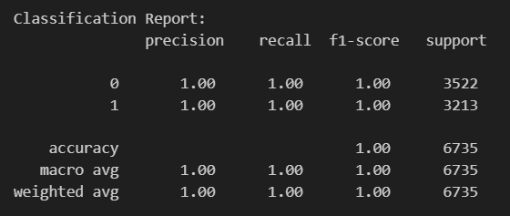
Accuracy Metrics
• Metrics Used: – Accuracy: Overall correctness of predictions. – Precision: Correct positive predictions over all predicted positives. – Recall: Correct positive predictions over all actual positives. – F1 Score: Harmonic mean of precision and recall.
• Reported Scores: – Accuracy: 99.97% – Precision: 99.97% – Recall: 99.97% – F1 Score: 99.97%
• Observations: – High scores across all metrics indicate strong model generalization. – Balanced performance suggests no overfitting or class bias.

Slide 9
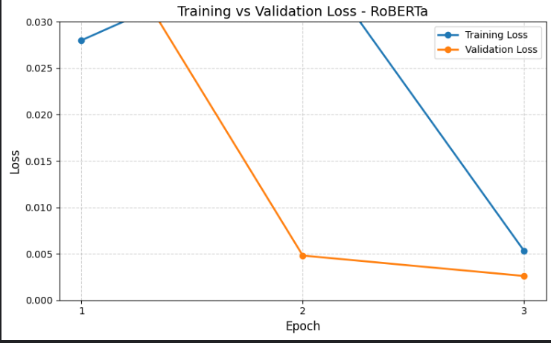
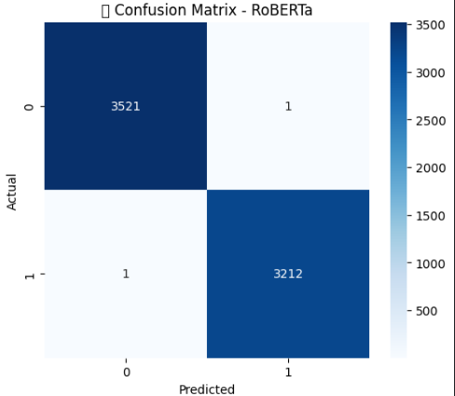
Visual Results
The training and validation losses show a rapid and consistent decrease across epochs, indicating effective learning. Both losses converge to near-zero values by Epoch 3, suggesting that the model is well-trained without signs of overfitting. The close alignment between training and validation losses reflects strong generalization performance.
The confusion matrix shows extremely high classification performance:
True Negatives (0,0): 3521
True Positives (1,1): 3212
False Positives and Negatives: Only 1 each
This suggests that the RoBERTa model has learned to distinguish between the two classes with near-perfect accuracy, making just 2 total misclassifications out of 6735 examples.

Slide 10
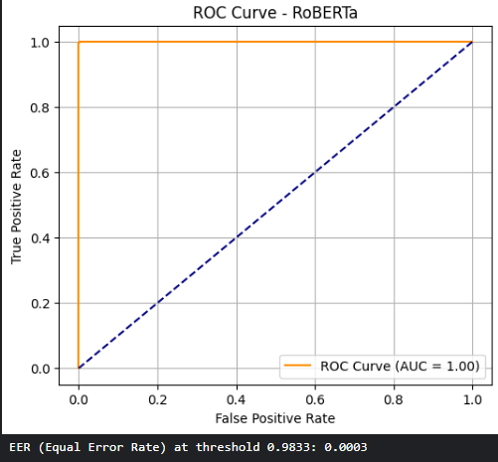
Visual Results
Observation: The ROC curve nearly hugs the top-left corner of the plot, achieving an AUC (Area Under Curve) of 1.00, which indicates perfect separation between the classes. The Equal Error Rate (EER) is 0.0003 at threshold 0.9833, showing an extremely low rate of incorrect predictions at the optimal threshold. This confirms that the model is highly robust, with a strong balance between sensitivity and specificity.

Slide 11
Contributions
Member 1: Varshitha
Role: Data Preparation & Model Integration
Lead
Contributions:
Dataset Handling
Tokenizer & Input Pipeline
Model Integration
Evaluation
Member 2: Dhanush
Role: Training & Optimization
Lead
Contributions:
Fine-Tuning Pipeline
Optimizer & Scheduler
Hyperparameter Tuning
Loss Curve Plotting
Member 3: Sripada
Role: Evaluation, Visualization & Documentation
Lead
Contributions:
Class Imbalance Handling
Evaluation
Result Visualization
Packaging & Deployment Prep
Joint Activities (All Members)
All three members collaboratively contributed to:
Research and literature review on RoBERTa and Fake News detection techniques.
Decision-making on model choice, architecture, and training strategy.
Daily standups, debugging sessions, and performance evaluations.
Preparing the final documentation and report.
We trained and tested two models FakeBERT and RoBERT. RoBERTa outperformed FakeBERT in all aspects.

